Slide 1

بِسمِ اللہِ الرَّحمٰنِ الرَّحِيم
"In (or with) the name of Allah, the Beneficent, the Merciful"

Slide 2


Ahmed Ali
Group
Members
18
Seher Ishtiaq
11

Slide 3

WI-FI
Driver Development
For Windows 10

Slide 4
Agenda
Testing
01
Introduction
05
02
06
Methodology
Deployment
03
Kernel & User Mode
07
Challenges
04
Implementation
08
Learning
05

Slide 5
1. Introduction To Wi-Fi Driver Development
With the increasing reliance on wireless networks for both personal and professional activities, the demand for optimized Wi-Fi drivers has grown significantly.
Developing robust and reliable wifi drivers is crucial for ensuring seamless wireless connectivity on Windows 10 devices.
Traditional Wi-Fi drivers often face challenges such as connectivity issues, compatibility issues with different hardware configurations, and suboptimal performance. These issues can lead to frustrating user experiences, including:
Slow internet speeds
Dropped connections
Limited range
1

Slide 6
Target Platform
Target platform is the Operating System or version for which driver has been developed.
Operating System:
Windows 10 (both 32-bit and 64-bit versions). This ensures broad compatibility with most modern Windows 10 machines.
The driver will be designed to enhance the reliability, stability, and overall performance of wireless connections for Windows 10 users. This means focusing on improvements in areas like:
Connection Stability: Minimizing dropouts and disconnects.
Data Transfer Rates: Optimizing speeds for browsing, streaming, and downloads.
Hardware Compatibility: Working seamlessly with a wide range of Wi-Fi adapters.
2

Slide 7
Functional Requirements
1. Wireless Connectivity
2. Network Discovery
3. Authentication & Encryption
The driver should facilitate seamless wireless connectivity to Wi-Fi networks.
Ability to scan for and identify available Wi-Fi networks within range,
Support for authentication methods (e.g., WPA2-PSK, WPA3) and encryption
protocols (e.g., AES) to ensure secure communication.
4. Configuration Options
5. Roaming Support
6. Diagnostic Tools
Enable users to configure network settings such as SSID, password, security type, and IP addressing (static or dynamic).
Smooth transition between different access points within the same network to maintain
uninterrupted connectivity while moving between coverage areas.
Include diagnostic capabilities to troubleshoot connectivity issues, such as signal
strength indicators, packet loss detection, and connection status reports.
3

Slide 8
Non-Functional Requirements
1. Perfomance
2. Reliability
3. Compatibility & Standardization
Ensure stable and consistent connectivity with minimal connection drops or interruptions.
Compatibility with a wide range of hardware configurations, including different Wi-Fi chipsets and device manufacturers.
Adherence to industry standards and regulations for wireless communication devices and software.
The driver should deliver high-speed data transmission rates with low latency, even under heavy network traffic conditions.
4. Security
5. Scalability
6. Resource Efficiency
Implement robust security measures to protect against unauthorized access, breaches, and cyber threats.
Refer to the Windows Driver Kit (WDK) and other SDK documentation to understand the APIs and tools available.
Optimize resource utilization, including memory and CPU usage, to minimize system impact and maximize performance.
4

Slide 9
2. Methodology
Development Tools
System Requirements
Micro soft Visual Studio , Windows Driver Kit(WDK) & Software Development Kit(SDK) .
4 or 8 GB RAM, 40 GB storage and windows 10 or above operating system(32 or 64 bit).
1
2
3
Language & Frameworks
C,C++, desktop development with C++ frame works, .Net frame work and driver development libraries.
5

Slide 10
3. Deciding between Kernel Mode & User Mode
Developing a Wi-Fi driver involves two primary modes: user mode and kernel mode. Here's a simplified explanation of the two:
User Mode:
User mode applications are built to interact with the user and perform tasks that do not require direct access to hardware or system resources.
1
Location
2
Advantages
3
Examples
User mode drivers run in a less privileged environment outside the core of the operating system. They have limited access to system resources and hardware.
They are easier to develop and debug, and their failures are less likely to cause system crashes.
Applications like Wi-Fi management tools or utilities typically run in user mode.
6

Slide 11
Deciding between Kernel & User Mode(cont..)
2. Kernel Mode:
kernel mode components, such as device drivers, interact directly with hardware and have privileged access to system resources.
1
Location
2
Advantages
3
Examples
Kernel mode drivers run in a privileged environment inside the core of the operating system. They have full access to system resources and hardware.
They have direct access to system resources, hardware, and memory.
Integration: Kernel mode drivers are tightly integrated with the operating system, allowing them to perform critical tasks efficiently.
The core Wi-Fi driver responsible for managing the wireless network interface operates in kernel mode.
7

Slide 12
4. Implementation
The implementation phase involves writing code to fulfil the specified requirements, including:
Device interaction
Data processing
Error handling
It encompasses translating design specifications into executable code, adhering to coding standards and best practices, and conducting rigorous testing to ensure functionality and reliability.
Additionally, documentation and version control are essential aspects of this phase to facilitate maintenance and future enhancements.
8

Slide 13
Main Functions Implemented
1. Entry
2. Driver Unload
3. Driver Create & Close
Initializes the driver and creates a device object.
Cleans up resources when the driver is unloaded.
Dispatch routines for handling create and close requests from user-mode applications.
9

Slide 14
Main Functions Implemented (cont..)
4. Device Control
5. Scan & Connect Network
6. Monitor Internet Speed
Dispatch routine for handling device control requests, including custom IOCTL codes.
Performs operations based on the IOCTL code, such as monitoring internet speed.
Dispatch routines for handling custom IRP functions, namely scanning devices and connecting to a network.
Placeholder function for monitoring internet speed. It should be replaced with actual implementation logic.
10

Slide 15
5. Testing
Functional Testing
1
Verify that the driver performs its intended functions correctly.
Unit testing is performed on each individual function and System testing of whole system.
2
Certification Testing
Consider using the Windows Hardware Certification Kit (HCK) to ensure your driver meets Microsoft's compatibility and performance standards. This can increase user confidence and marketability for your driver.
Compatibility Testing
3
Ensure that the driver works seamlessly with target versions of Windows.
By testing your drivers on target devices using the Windows Driver Kit, you can identify and fix any issues before deploying them to end users.
11

Slide 16
Provisioning Testing System
Disable Secure Boot
Test signing on
Install WDK
Pinging
Install WDK on target system and run x64 exe.
Disable secure boot from BIOS press esc key to enter.
Run bcdedit \set testsigning on at Cmd.
Ping both Systems by IP address. Also turn fire wall off.
12

Slide 17
Provisioning Host System
Repeat the first 4 steps of provisioning the target system. Step 5 onwards.
Inbound rules
New Inbound rule
Configure Device
Restart Systems
Open control panel > Advance setting > Inbound Rules
Define new rule for IPv4 add target system IP address allow incoming.
Configure target device from Visual Studio extensions for communication.
Restart both systems and debug program from host this may restart system many time.
13

Slide 18
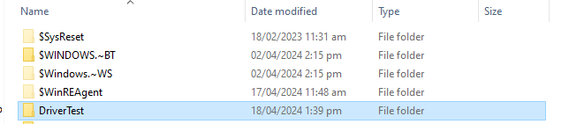

6. Deployment
After successful deployment a new folder name DriverTest will be created in C drive that contains necessary files of the newly deployed driver.
This contain all necessary files in it like .inf .sys and other setup and executable files.
14

Slide 19
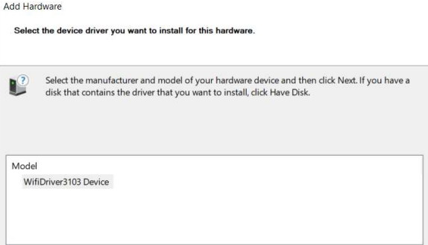
Deployment (cont…)
To add this in system open device manager > Add new legacy device from Action > Choose required file from directory.
15

Slide 20
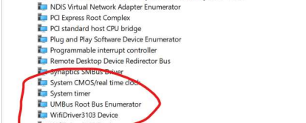
Deployment (cont…)
The driver has be deployed successfully as shown in figure below under the name WifiDriver3103.
16

Slide 21



7. Challenges in Wi-Fi Driver Development
ISSUE
RESOLUTIONS
OUTCOMES
Problems In Project Development
Solution to the provided problem
After Resolving error how project work
1
Spectre Mitigated Error
1
adding X64 latest specter
1
Fix latest security patches and protest against vulnerabilities.
2
Learning Curve
2
WDK documentation, online tutorials, and sample driver projects
2
Helped in development
Ensure both machines are on the same network with proper IP addresses
3
Pinging Systems
3
3
Successful provisioning
17

Slide 22
8. Learnings From Project
Planning
Tools Utilization
Coding & Documentation
Importance of thorough planning and preparation is very important it is the thing that help you throughout your life.
Effective utilization of debugging tools we have learned Visual Studio, WDK, deployment process and libraries I am confident now as never before.
Significance of code organization and documentation.
And why documentation of each step is necessary in this field.
Enhanced Understanding
Problem Solving Skills
Resources Understanding
Enhanced understanding of driver development concepts. How drivers work in different modes and why they are essential component of Operating system.
Improved problem-solving skills how to solve problems and how to interact with online community specially over stack overflow.
Deep understanding of hardware, resources, ports, and kernel working.
18

Slide 23

Thank You
Thank you for your attention

